Slide 1
Search Algorithms: Object-Oriented Implementation (Part F)

Slide 2
Contents
Conventional vs. AI Algorithms
Local Search Algorithms
Implementing Hill-Climbing Algorithms
Defining ‘Problem’ Class
Adding Gradient Descent
Defining ‘HillClimbing’ Class
Adding More Algorithms and Classes
Genetic Algorithm
Adding Genetic Algorithm
Experiments

Slide 3
Genetic Algorithm (GA)
유전 알고리즘

Slide 4
Genetic Algorithm
Genetic Algorithm, GA(유전 알고리즘)
  A computational model based on the evolutionary process and genetic laws of the natural world, developed by John Holland in 1975 as a Global Optimization Method.
  It is a representative technique of evolutionary computation that mimics the evolution of living organisms, borrowing many elements from the actual process of evolution. Concepts like mutation, crossover (recombination) operation, generation, and population are used in the problem-solving process.
  When a problem is too complex to be computationally feasible (NP-hard, etc.), the Genetic Algorithm can be used to obtain a solution close to the optimal solution, even if the true optimal solution cannot be found.
https://ko.wikipedia.org/wiki/유전_알고리즘

Slide 5
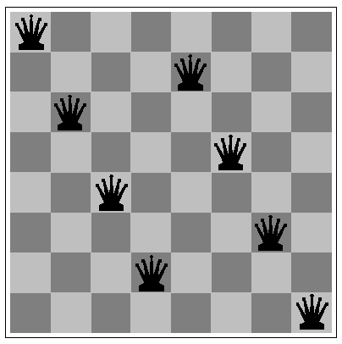
Genetic Algorithm
Starts with a population of individuals (다수의 개별 솔루션으로 시작)
  Each individual (state=솔루션) is represented as a string over a finite alphabet (called chromosome, 염색체)—most commonly, a string of 0s and 1s (binary)
  The method predominantly used to represent each Individual (state = solution) is a string of 0s and 1s (binary) (to be explained later).
예: 8 queens 문제에서의 하나의 솔루션(state)
1 | 3 | 5 | 7 | 2 | 4 | 6 | 8
Column-by-column integer representation
(솔루션=각 열에서 queen의 위치)

Slide 6
Genetic Algorithm
Each individual is rated by the fitness function
  Solutions are selected based on the fitness value, and the selected solutions are used to generate offspring (offspring = next solution, offspring generation = reproduction).
  An individual is selected for reproduction by the probability proportional to the fitness score
(참고) Local search algorithms that do not use any problem-specific heuristics is called “metaheuristic algo.”
Simulated annealing and GA use meta-level heuristic → metaheuristic algorithms
Thereby,
Steepest Ascent, First-Choice, Stochastic, Gradient Descent, etc., use heuristic techniques that are specialized for a given problem. (They are effective in solving the given problem, but cannot be applied to other problems.)
Simulated Annealing and GA propose heuristic techniques using general ideas (such as annealing in daily life or genetic laws in nature) that are not specific to a given problem. (They do not change depending on the problem to be solved and can be applied to any problem.)

Slide 7
Genetic Algorithm
Selected pair are mated (짝짓기) by a crossover (교차 연산)
  After selecting a pair of chromosomes (=solutions), a new solution is generated using the 'crossover operation' method, which involves randomly cutting the two chromosomes and splicing the resulting parts crosswise.
  In this process, the crossover point (the cutting point) is determined randomly and can be a single point or multiple points.
  Crossover frequently happens in the state space early in the search process when the population is quite diverse, and less frequently later on when most individuals are quite similar (다음 페이지…)
  ▶ This is similar to the principle used in algorithms like Gradient Descent and Simulated Annealing, where early in the learning process, the solutions are changed significantly (or the probability of selecting a poor solution is increased), and later in the learning process, the degree to which solutions are updated is reduced.
Crossover points (자르는 지점) are chosen randomly

Slide 8
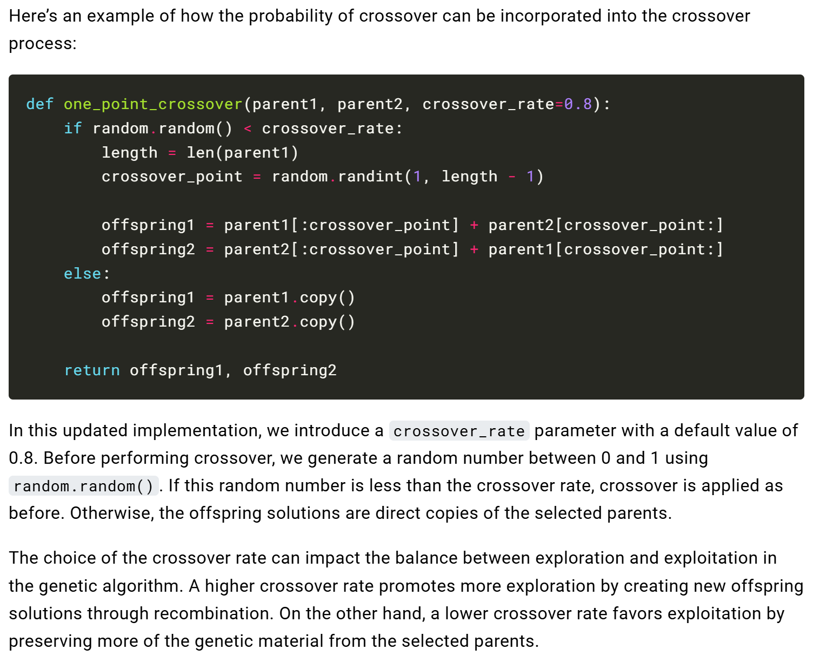
Genetic Algorithm
Selected pair are mated (짝짓기) by a crossover (교차 연산)
* Note
In the lecture, we will implement Crossover using different logic from the code shown here. Please review the code provided here for reference only.
https://algorithmafternoon.com/books/genetic_algorithm/chapter05/

Slide 9
Genetic Algorithm
Mutation Operation:
  The mutation operation is applied after Crossover.
  Each position (locus) in the chromosome (solution) is randomly changed with a small probability.
    Each locus(위치,장소) is subject to random mutation with a small independent probability
Advantages of the GA Technique :
  crossover:
    A method that combines two solutions that have been repeatedly developed/improved.
    This significantly improves the solution quality (which is the main characteristic and the biggest advantage of the GA technique).
  Mutation:
    Random variations are applied to the new solutions created by Crossover.
    The Mutation operation applies random changes to a single solution through 'randomness' to search for better solutions.

Slide 10
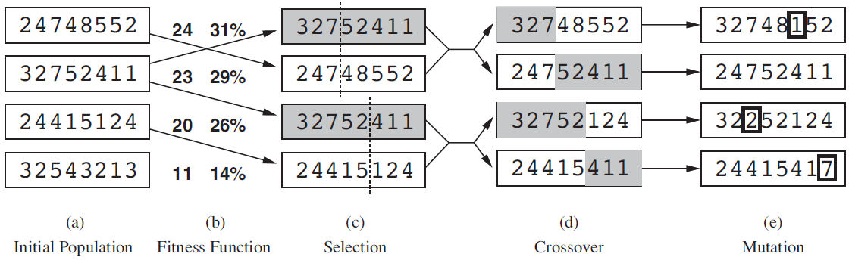
Genetic Algorithm
31% = 24 / (24+23+20+11)
Example of GA applied to the 8-Queens problem
Starts with a diverse set of randomly selected solutions (initial population).
Calculates the fitness score for the selected solutions.
Each solution is selected with a probability proportional to its fitness function value.
Two solutions are selected, and crossover is performed based on a random point to combine the two solutions and generate a new solution.
Mutation (random change) is applied to each generated solution at a random position. However, since this process is probabilistic, there are cases where mutation is not applied.

Slide 11
Genetic Algorithm
function GENETIC-ALGORITHM(population, FITNESS-FN) returns an individual
inputs: population, a set of individuals
FITNESS-FN, a function that measures the fitness of an individual
repeat
new_population ← empty set
for i = 1 to SIZE(population) do
(x, y) ← SELECT-PARENTS(population, FITNESS-FN)
child ← REPRODUCE(x, y)
if (small random probability) then child ← MUTATE(child)
add child to new_population
population ← new_population
until some individual is fit enough, or enough time has elapsed
return the best individual in population, according to FITNESS-FN
an initial set of randomly generated solutions
Create an empty set to store the next generation's solutions
Generate new solutions until “new solutions = current population size.”
Select two solutions by fitness scores
Create a new solution (child) by crossing over the two parent solutions.
Randomly change the solution
Add the newly generated solution to new_population.
population = new_population
best solution

Slide 12
Genetic Algorithm
Parent selection by binary tournament:
  Randomly select two (2) individuals with replacement (i.e., the same solution can be selected twice) without considering their fitness score
  Select the one with the best fitness as the winner (ties are broken randomly)
Repeat the above process twice to select two parents from the current set of solutions.
Use the two selected parent solutions to generate one child (=next solution).
Binary
Tournament

Slide 13
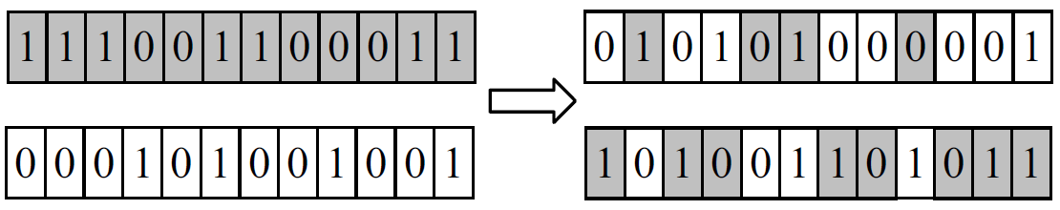
Genetic Algorithm
Uniform crossover:
  Each gene is chosen from either parent stochastically by flipping coin at each locus (위치, 장소)
  If the probability of head p = 0.5, the average number of crossover points is l/2, where l is the length of the chromosome (p=0.5이면 평균적으로 절반이 교차됨)
  p = 0.2 is a popular choice
After parent selection, crossover is carried out according to the probability called crossover rate
  This is the probability that determines whether the crossover operation itself is performed. It is generally recommended to use a probability close to 1 (or a value that dynamically decreases over time may be used).
Uniform crossover is performed on two parents selected through the binary tournament.
Whether to perform crossover at each position is determined randomly (The image on the left shows an example where 6 crossover points are selected).
The crossover operation is performed to generate two children from two parents.

Slide 14
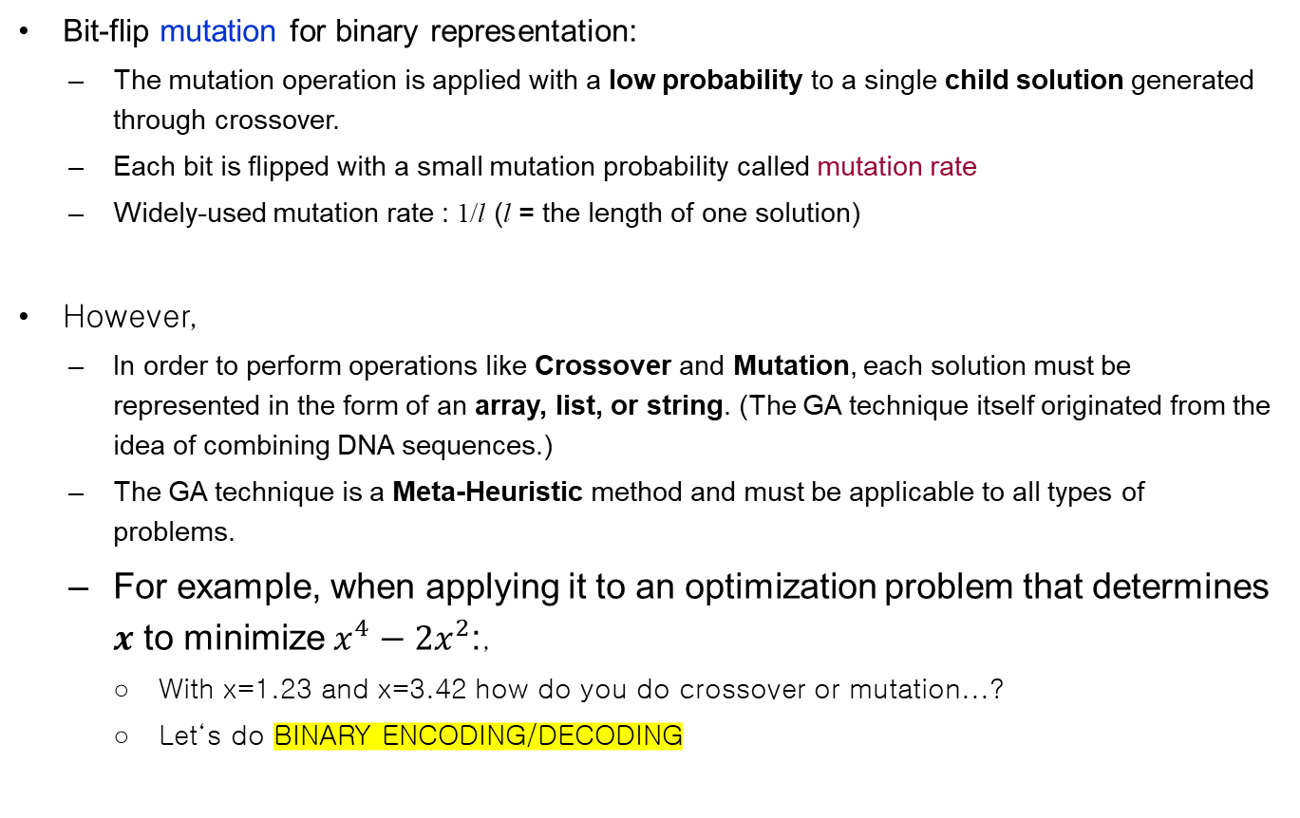
Genetic Algorithm
Bit-flip mutation for binary representation:
  The mutation operation is applied with a low probability to a single child solution generated through crossover.
  Each bit is flipped with a small mutation probability called mutation rate
  Widely-used mutation rate : 1/l (l = the length of one solution)
However,
  In order to perform operations like Crossover and Mutation, each solution must be represented in the form of an array, list, or string. (The GA technique itself originated from the idea of combining DNA sequences.)
  The GA technique is a Meta-Heuristic method and must be applicable to all types of problems.
  For example, when applying it to an optimization problem that determines $x$ to minimize $x^{4}−2x^{2}$:,
    With x=1.23 and x=3.42 how do you do crossover or mutation...?
    Let‘s do BINARY ENCODING/DECODING

Slide 15
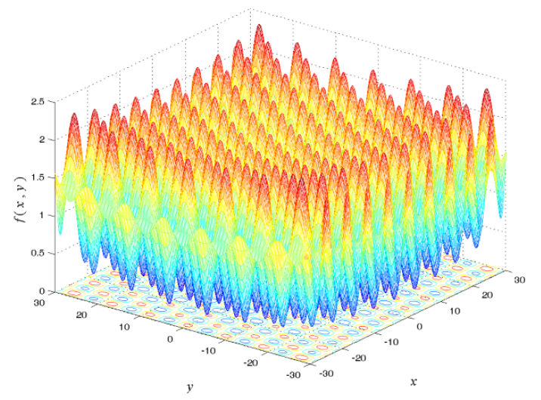
Genetic Algorithm
Example: Binary encoding/decoding for numerical optimization
  Assuming a 10-bit binary encoding for each variable, the code shown below can be decoded as (= discretization)
2-D Griewank function
min
In case of 10-bit, the maximum representation value is 2¹⁰-1.
therefore, representing 10-bit by dividing by 2^10, it becomes a real number between (0,1).
This value is scaled and shifted to convert it into a number within the valid range.
Note: as n in n-bit representation increases, the accuracy of the solution and computational load also increased
max
Dividing by 2^10 for 10-bit rep.
x =
0 | 1 | 0 | 0 | 0 | 1 | 0 | 0 | 0 | 1
Above: Example of generating one arbitrary solution (assuming the solution range is -30 to +30)
[1] Generate an arbitrary combination of [10 bits] and divide it by 2^10 (the result is a real number between 0 and 1).
[2] Multiply the [calculated real number] by the total range (=60) to scale the number to be between 0 and 60.
[3] Add -30 to shift the value into the valid range.
Loss of information occurs due to Discretization, which can lead to solution quality degradation.
However, it can reduce computational and memory usage.
(Example) Deep learning Model Optimization – Quantization.

Slide 16
Genetic Algorithm
Example for combinatorial problem (TSP)
  Genetic operators for permutation code (e.g., for TSP):
    The method used to represent information like the order of visits is called a permutation code.
    Special caution is required in these types of problems.
    This is because invalid solutions can be generated during the operations like crossover and mutation.
    Ex:
      [1,2,3,4] + [4,3,2,1] => [1,2,2,1]
      The original two solutions are valid, but the solution created by crossover is invalid (it does not visit all cities).

Slide 17
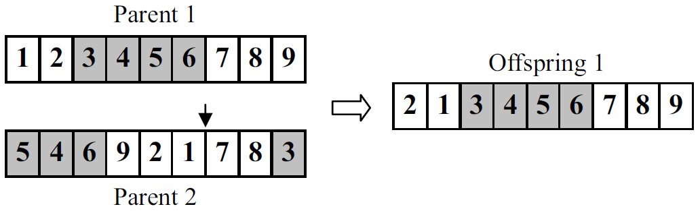
Genetic Algorithm
The method used to represent information like the order of visits.
Example for combinatorial problem (TSP)
  Genetic operators for permutation code (e.g., for TSP):
    How to generate mutation from a single solution: : Simple inversion mutation
    How to cross over and combine two solutions: Ordered crossover (OX)
      Ex: Parent 1’s 3-4-5-6 is preserved/maintained
If two solutions are simply combined based on a Crossover point, certain city indices may disappear or duplicate visits may occur.
Left image operation example :
Select a start point and an end point from Parent 1, and copy the solution within that range as is
=> [?, ?, 3, 4, 5, 6, ?, ?, ?]
From Parent 2, starting after the end index of Parent 1, copy the remaining values in order, excluding values already included in the offspring, to create the new solution.
(2)
(1)
(3)
(4)
(5)

Slide 18
Genetic Algorithm
In the case of permutation code
  Crossover rate is the probability of whether or not to perform the ordered crossover
    The probability that determines whether or not to perform the crossover operation using two solutions.
  Similarly, mutation rate is the probability of whether or not to perform the inversion
    The probability that determines whether or not to perform the mutation operation on a single solution.
    Note that mutation in TSP = mutate by inversion.

Slide 19
Genetic Algorithm (GA) Implementation

Slide 20
Adding Genetic Algorithm
We add a subclass GA under MetaHeuristics in the Optimizer class hierarchy
  Accordingly, many problem-dependent
  methods for GA are added to the Problem
  class
GA has seven variables:
  popSize: population size (size of the solution set)
  uXp: swap probability for uniform crossover
  used in numerical optimization (determine whether or not
  to cross over at each position of a solution of length l)
  mrF: multiplication factor to (1/l) for bit-flip
  mutation used in numerical optimization (A value used to
  determine the mutation probability)
  XR: crossover rate for the permutation code
  for TSP (The probability that determines whether
  or not to perform the crossover operation)
GA
popSize
uXp
mrF
XR
mR
pC
pM
__init__
setVariables
displaySettings
run
evalAndFindBest
selectParents
selectTwo
binaryTournament
numerical
opt.
TSP

Slide 21
Adding Genetic Algorithm
  mR: mutation rate for the permutation code for solving TSP
  pC: crossover probability (uXp or XR)
  pM: mutation probability (mrF or mR)
The setVariables method, after setting popSize, sets the variables (pC, pM) to either the values of (uXp, mrF) or those of (XR, mR) depending on whether the problem to solve is numerical optimization or TSP, respectively
  While (pC, pM) are the parameters of the search algorithm, the user only gives the values of (uXp, mrF) or (XR, mR)
For binary code (Numeric)
For permutation code (TSP)
For Numeric
For TSP

Slide 22
Adding Genetic Algorithm
resolution : number of bits for binary-encoding
displaySetting shows the population size and the parameter values used by the genetic operators
  resolution, uXp, and mrF for a numerical optimization problem
  XR and mR for a TSP
The genetic algorithm itself is implemented as the run method of the class
  (note) Among the many different genetic algorithms, our implementation is just one of them. In other words, there are diverse ways to implement GA
  The population is a list of individuals
  An individual is a list of a pair: [fitness, chromosome]
    That is, the first item in the list storing each solution is the fitness score.
  The run method makes calls to some methods of Problem class and other methods within the GA class (run use both Problem class and GA class methods)

Slide 23
Adding Genetic Algorithm
run(self, p):
  Generates an initial population randomly (p.initializePop)
  Evaluates individuals in the initial population and identifies the best one (self.evalAndFindBest)
  Until termination, keeps applying the genetic operators (self.selectParents, p.crossover, p.mutation), updating the population (= generate next solution set), and updating the best-so-far individual (self.evalAndFindBest)
  Converts the best individual found to a form containing only the solution part (p.indToSol)
    Since each individual = [fitness, solution], the indToSol method is implemented to extract only the solution part.
    ind = individual
  Stores the best solution (p.storeResult)

Slide 24
Adding Genetic Algorithm
evalAndFindBest(self, pop, p):
  Evaluates each individual in the population pop (p.evalInd), identifies the best one, and returns it
selectParents(self, pop):
  Performs binary tournament selection twice (self.selectTwo, self.binaryTournament) and returns the selected parents
  Selects two solutions by performing the process of randomly selecting two parents using selectTwo and then choosing the parent with the lower fitness score via binaryTournament, repeating this process twice.
selectTwo(self, pop):
  Selects two random individuals in pop and returns them
binaryTournament(self, ind1, ind2):
  Returns the better solution between the two solutions (ind1, ind2).
  Returns the individual (solution) whose fitness score (which is ind1[0], ind2[0]) is "smaller".
    The fitness score is the result of the evaluation, and since we are solving a minimization problem, the solution with the "smaller" fitness score is the "better" solution.

Slide 25
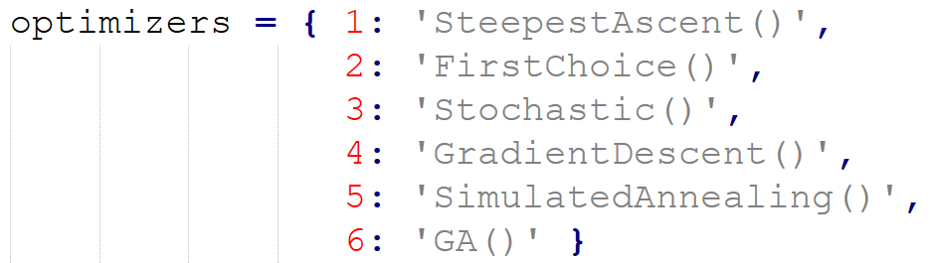
Changes to ‘Setup’ Class
A variable named resolution is newly added
  It represents the length of the binary string for each variable for a numeric optimization problem
  It is referenced by the methods in both the classes Optimizer and Problem
The setVariables method is accordingly changed
Changes to the main program is minimal
  readPlan is revised to read in more parameter values such as the population size, crossover rate, mutation rate, etc.
  createOptimizer is revised to include GA as its 6th optimizer

Slide 26
Changes to ‘Problem’ Class
Many methods are added to the classes Numeric and Tsp to support operations needed to conduct the search by genetic algorithm
We first describe the five methods that are commonly added to both Numeric and Tsp
  initializePop(self, size):
    Makes a population of given size with randomly generated individuals, and returns it (= 랜덤하게 size 수 만큼의 솔루션을 생성)
    In Numeric, the individual chromosome for GA is represented by a binary string that is different from that used by other algorithms (self.randBinStr)
    In Tsp, the individual chromosome for GA is represented by permutation code that is also used by other search algorithms (self.randomInit)
      permutation code = uses the result of permuting city numbers, represented as int, as the solution.

Slide 27
Changes to ‘Problem’ Class
  evalInd(self, ind):
    Evaluates the chromosome of ind and records the fitness value (self.evaluate)
    In Numeric, however, the binary string must be decoded before it can be evaluated (self.decode)
    The calculated fitness score is stored at index 0 of the passed-in individual.
  crossover(self, ind1, ind2, pC):
    Performs crossover to parents and returns the resulting children
    In Numeric, a uniform crossover is performed interpreting pC as the swap probatility uXp (self.uXover)
      Decides whether or not to perform crossover at each position.
    In Tsp, an ordered crossover is performed interpreting pC as the crossover rate XR (self.oXover)
      Decides whether or not to perform the crossover operation itself.
      If performed, a random range is generated, and ordered crossover is carried out based on this range.

Slide 28
Changes to ‘Problem’ Class
  mutation(self, ind, pM):
    Performs mutation to ind and returns it (Performs solution variation on a single solution)
    In Numeric, a bit-flip mutation is performed interpreting pM as the factor mrF to adjust the mutation rate
      Randomly performs bit flip for each index of the solution.
    In Tsp, an inversion operation is performed interpreting pM as the mutation rate mR (self.inversion)
      Generates a random start and end position and Inverts the values within that range (mutate by inversion).
  indToSol(self, ind):
    Converts an individual to a form containing only the solution part
      Since the input argument ind stores [fitness, solution], it returns everything except the fitness.
      In other words, return self.decode(ind[1])
      Note that indToSol function called in GA.run use bestSolution = p.indToSol(best)
    In Numeric, the chromosome is decoded and then returned (self.decode)
    In Tsp, just the chromosome part of ind is returned

Slide 29
Changes to ‘Problem’ Class
We now describe the methods that are added only to Numeric
  randBinStr(self):
    Generates a random binary string of a predetermined length (self._resolution), and returns it
  decode(self, chromosome):
    Decodes each variable in chromosome to its decimal value (self.binaryToDecimal), concatenates them to a solution form, and returns it
  binaryToDecimal(self, binCode, l, u):
    Decodes binCode to a decimal value taking the domain and resolution into account, and returns it
  uXover(self, chrInd1, chrInd2, uXp):
    Performs uniform crossover to two chromosomes chrInd1 and chrInd2, and returns the resulting chromosomes

Slide 30
Changes to ‘Problem’ Class
We now describe one method that is added only to Tsp
  oXover(self, chrInd1, chrInd2):
    Performs ordered crossover to two chromosomes chrInd1 and chrInd2, and returns the resulting chromosomes

Slide 31
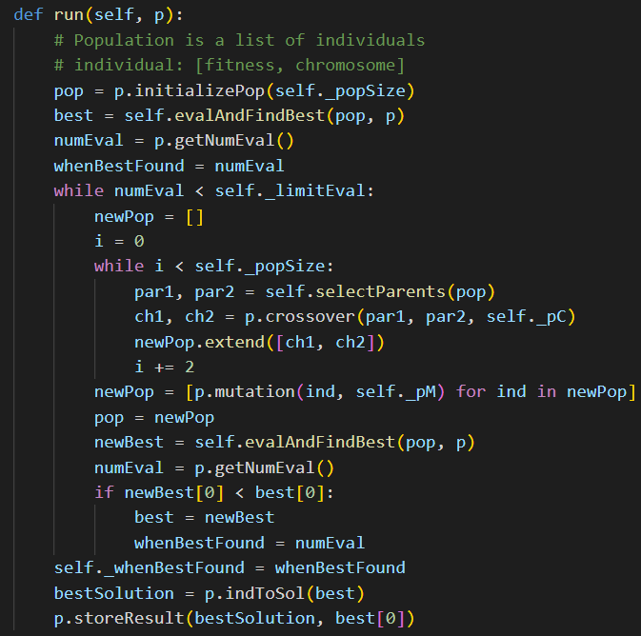
Code sample for GA
Generates the initial population set.
Selects two soln. from current pop.
Crossover on two parents to generate two new child soln.
Applies the mutation operation to the generated solutions (ind=individual solution)
Updates the overall best solution found so far.

Slide 32
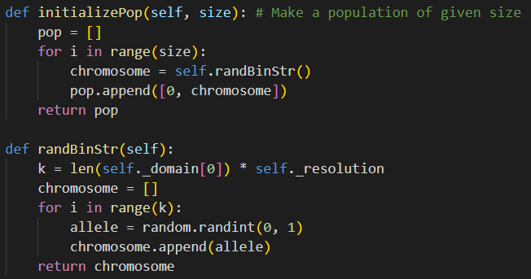
Code sample for Numeric problems
Generate initial solution set (Each solution is encoded as a 0/1 binary string)
Fitness score
k = {number of variables} * {length of the binary encoding string to represent each variable}
Randomly generate an initial solution (Each solution is encoded as a 0/1 binary string)
The r-bit binary strings representing N variables are all concatenated and stored as a single list

Slide 33
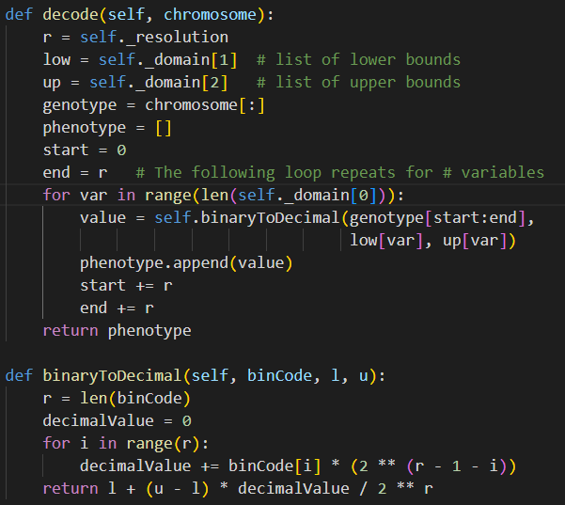
Code sample for Numeric problems
Function to convert each 0/1 binary list (chromosome) into a list of real (floating-point) values
The r-bit binary strings representing N variables are all concatenated and stored as a single 1D list. To extract the binary string corresponding to each variable, you must index using [start:end] at the relevant positions
Convert the value encoded as a 0/1 binary string into a real (floating-point) value (A real value is needed when evaluating the solution/fitness)

Slide 34
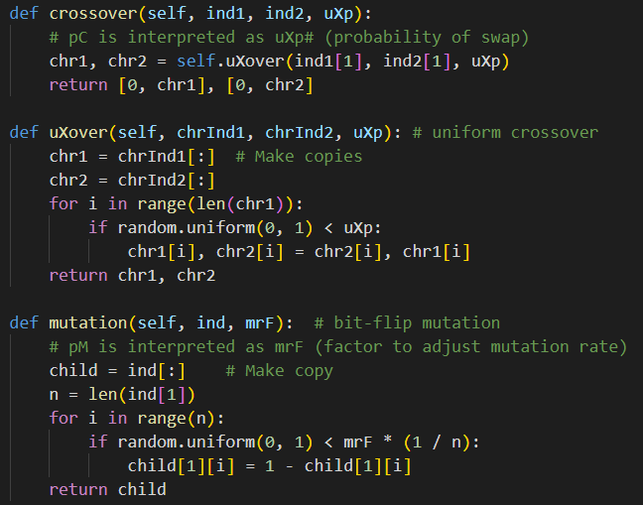
Code sample for Numeric problems
Operation that combines two solutions through crossover
For each index of the binary string representing a solution, perform the crossover operation according to a probability
For each index of the binary string representing a single solution, perform the bit-flip operation according to a probability

Slide 35
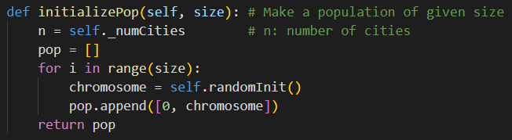
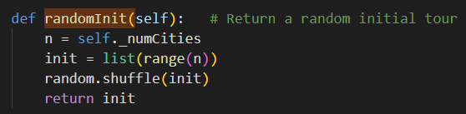
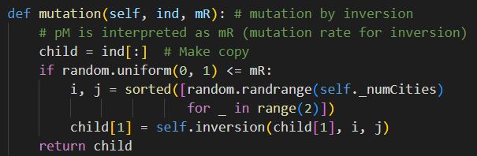
Code sample for TSP problems
Initially, generate 'size' number of initial random solutions
Reverse the order of values within the range

Slide 36
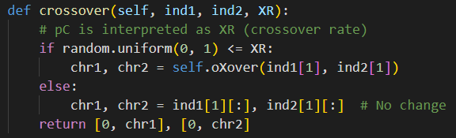
Code sample for TSP problems
Decide whether or not to perform crossover based on the XR (Crossover Rate) probability
  If not performed, return the two solutions (ind1, ind2) as is (unchanged)

Slide 37
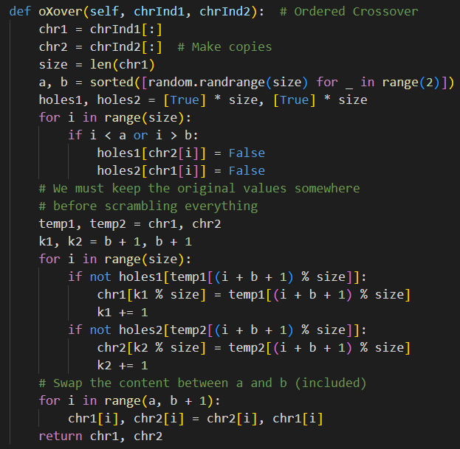
Code sample for TSP problems
deep copy
Randomly generate range a, b
Mark numbers not included in the selected range as False
Starting from index b+1, copy the numbers not included in the selected range in sequential order
chr1 :
  Values within the [a,b] range are taken from chr2
  Values outside the range are taken from chr1
chr2 :
  Values within the [a,b] range are taken from chr1
  Values outside the range are taken from chr2
Swap the numbers within the set range

Slide 38

Experiments
Solve the given 6 problems using all algorithms implemented so far, and compare their performance.

Slide 39
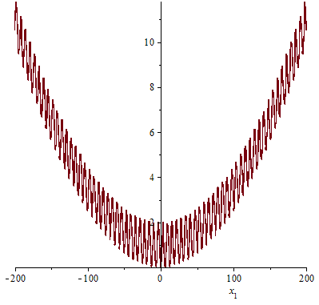
Experiments
We solve a few numerical optimization problems and TSPs using various search algorithms made available in our optimization tool and compare their performances
We try three numerical optimization problems all of which are five dimensional with the search space of –30 ≤ x_{i} ≤ 30 for 1 ≤ i ≤ 5
  Convex function:
  (x₁ – 2)² + 5(x₂ – 5)² + 8(x₃ + 8)² + 3(x₄ + 1)² + 6(x₅ – 7)²
  Griewank function:
  with a global minimum of 0 at all zeros
One-dimensional Griewank function

Slide 40
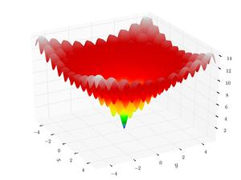
Experiments
  Ackley function:
  with a global minimum of 0 at all zeros
We also try three versions of TSPs
with different numbers of cities located
in a 100 × 100 square
  We use TSP-N as the name of a
  TSP with N cities, where N is 30,
  50, and 100
Two-dimensional Ackley function

Slide 41
Experimental Setting
Step size of mutation for the three hill climbers steepest-ascent, first-choice, and stochastic: 0.01
For the gradient descent algorithm:
  Update rate: 0.01
  Size of dx for calculating gradient: 10^{–4}
For the two hill climbers first-choice and stochastic:
  Consecutive iterations allowed for no improvement: 1,000
For the two metaheuristic algorithms:
  The total number of evaluations until termination: 500,000
x ← x – α ∇f(x)

Slide 42
Experimental Setting
Population size of GA: 100
GA for numerical optimization:
  The length of binary chromosome per variable: 10
  Swap probability for uniform crossover: 0.2
  Multiplication factor to 1/l for mutation (l: length of chromosome): 1
    Thereby, the probability to mutate for each index is =1*1/ l
GA for TSP:
  Crossover (ordered crossover) rate: 0.5
  Mutation (inversion) rate: 0.2

Slide 43
Experimental Results
The numbers shown in the table are the averages of 10 experiments
  All the hill climbers are randomly restarted by 10 times in each experiment
The four numbers in each cell represent the following:
  Average objective value (left top)
  Best objective value found (left bottom)
  Average number of evaluations (right top)
  Average iteration of finding the best solution (right bottom)
  (only for GA and Simulated Annealing)
Bold-faced letters indicate the best result among different optimizers
For TSPs, the results are compared with those obtained by the nearest-neighbor algorithm, which starts from a random city and keeps visiting the one that is the closest (무작위로 선택된 도시에서 출발하고, 가장 가까운 도시를 방문하는 전략)

Slide 44
Experimental Results
Convex function:
  All the algorithms except GA found the optimal solution
  Gradient descent reaches the optimum the fastest
  (SA is faster but it does not terminate automatically)
  First-choice is faster than steepest-ascent
Griewank function:
  GA performs much better than the others
  SA performs worse than the hill climbers
Ackley function:
  GA is much better than the others
  SA performs worse than the hill climbers

Slide 45
Experimental Results
TSPs:
  Steepest-ascent is worse than nearest-neighbor
  Stochastic shows the best average performance with TSP-50
    But it took too many iterations to solve TSP-100
  SA shows the overall best performance
  GA does not show any competitive performance when the problem size is small (TSP-30)
The quality of the solution found by metaheuristic algorithms is better than that by hill climbers for most problems
A hill climber should be the choice if the problem is convex
The results reported here are obtained without enough parameter tuning (more careful investigation is needed)

Slide 46
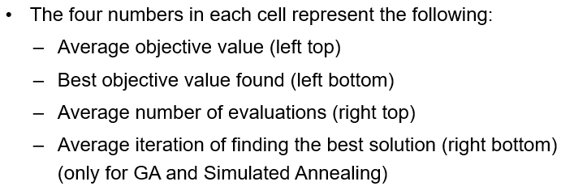
Results of Numerical Optimization
 | Convex |  | Griewank |  | Ackley
Steepest Ascent | 0.0 0.0 | 774,692 | 0.260 0.108 | 67,144 | 17.832 14.029 | 12,182
First Choice | 0.0 0.0 | 274,521 | 0.254 0.064 | 38,824 | 18.214 14.108 | 14,377
Stochastic | 0.0 0.0 | 2,088,171 | 0.218 0.096 | 387,008 | 18.879 16.729 | 141,156
Gradient Descent | 0.0 0.0 | 199,935 | 0.216 0.118 | 856,635 | 17.447 8.101 | 5,234
Simulated Annealing | 0.0 0.0 | 500,000 63,565 | 0.367 0.145 | 500,000 18,252 | 19.319 18.940 | 500,000 5,541
GA | 3.920 0.766 | 500,000 227,140 | 0.036 0.015 | 500,000 220,390 | 0.214 0.141 | 500,000 173,900

Slide 47
Results of Combinatorial Optimization (TSP)
 | TSP-30 |  | TSP-50 |  | TSP-100
Steepest Ascent | 593 525 | 6,846 | 782 678 | 20,211 | 1,223 1,145 | 88,254
First Choice | 424 408 | 30,154 | 578 561 | 57,207 | 903 869 | 131,450
Stochastic | 422 408 | 670,952 | 570 561 | 2,395,138 | 872 840 | 10,903,041
Nearest Neighbor | 509 455 |  | 694 646 |  | 958 918
Simulated Annealing | 412 408 | 500,000 28,831 | 577 559 | 500,000 43,962 | 829 804 | 500,000 69,084
GA | 658 635 | 500,000 245,940 | 584 558 | 500,000 226,840 | 854 822 | 422,650

